Slide 1

The Politics of Results and Transformational Development
– What Needs to Change?

Slide 2
Programme
13-14.15 Book launch
Rosalind Eyben
Cathy Shutt
Janet Vähämäki
14.15-14.45 Coffee
14.45 Panel discussion
Ulrica Modéer, State Secretary
Kim Forss, Evaluation and development specialist
Henrik Arnstad, Journalist
Anna Liljelund, Advisor/Consultant

Slide 3
The Politics of Results and Transformational Development
– What Needs to Change?
Rosalind Eyben
Professor Emeritus and Editor,
Institute for Development Studies

Slide 4

Introduction to the book
Origins
Key themes
Strategies for change

Slide 5
No one disputes the need to seek evidence and understand results. Everyone wants to see clear signs of less poverty, less inequity, less conflict and more sustainability, and to understand what has made this possible.

Slide 6
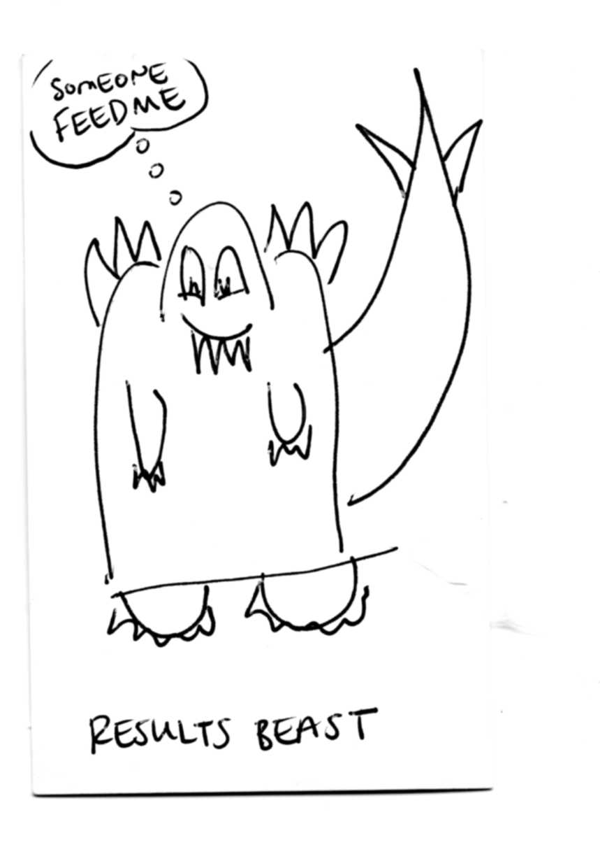
The Issue
International aid has increasingly been favouring quick, easily-measurable results over long-term support to locally-generated complex processes of transformative social change.

Slide 7

The Big Push Forward has sought to create the political space for discussion, debate and the exploration of approaches for supporting and assessing transformative development processes.

Slide 8
Themes in the book’s case studies of practitioner experience
The dynamics of pressure and response to the results agenda;
Rights and results: transformational and transactional approaches;
Does it have to be a choice between learning and accountability ?

Slide 9
Playing the game to change the rules
Develop personal agency to push back;
Identify and seize political opportunities;
Work with what is positive about the results agenda;
Facilitate front-line staff to speak for themselves;
Create spaces for learning and influence;
Advocate and support collective action.

Slide 10
The Politics of Results and Transformational Development
– What Needs to Change?
Cathy Shutt
Co-editor

Slide 11

The Politics and
Practice of VFM
Cathy Shutt
Independent Consultant

Slide 12
Outline
Chapter aims and current relevance
My side of the VFM story:
  The 2010 political push
  Confusion, collaboration and shaping the agenda
  2013: Contingent effects
  Tactics for increasing transformative potential
Conclusions: What needs to change?

Slide 13
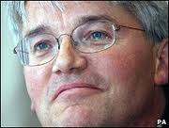

2010: The Big Political Push
“Our bargain with taxpayers is this,” says International Development Secretary Andrew Mitchell. “In return for contributing your money to help the world’s poorest people, it is our duty to spend every penny of aid effectively. My top priority will be to secure maximum value for money in aid through greater transparency, rigorous independent evaluation and an unremitting focus on results.”
Action Aid press release 21 October 2010 http://www.actionaid.org.uk/102638/press_release.html

Slide 14
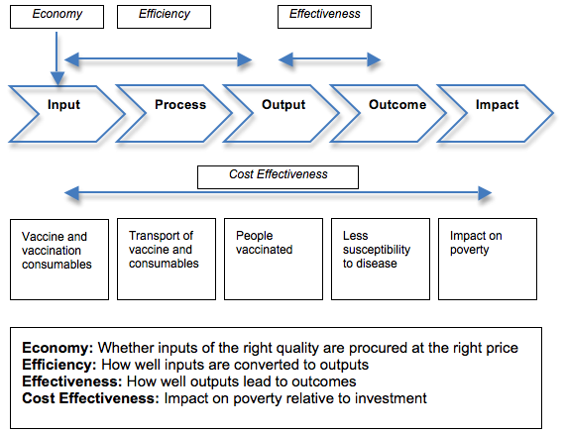
DFID’s 3E VFM Framework

Slide 15

Confusion
“It’s quite frustrating because – as per DFID’s TOR – we’ve only got 6 pages on results (from quite a complex, global programme) and yet 3/4 pages on V4M with very limited guidance from DFID on what we should focus on (we were told they don’t know yet and expect us to take the lead in defining). Did you see the call for PPA proposals? Narrow definition there; focuses more on efficiency rather than allowing for any broader argument about the effectiveness of a governance approach as we would hope. We’ve decided not to dedicate hours to untangling this for the PPA evaluation”

Slide 16
2010 Big Push Back Meeting
Whose values?
How can equity considerations be addressed?
How should partnerships be valued?
How can neoclassical concepts like ‘efficiency’ be applied in inequitable aid relationships ?
How can non-financial costs like those of volunteers, particularly women - be valued appropriately?

Slide 17


Different Philosophical Underpinnings
  VFM:
  Managerial approach to ‘transactional’ development?
  or
  Political approach to transformational social change?

Slide 18

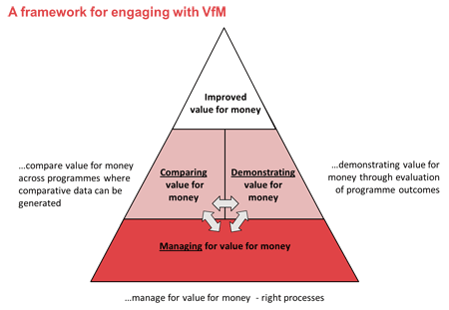
NGOs shaping the
VFM Agenda

Slide 19
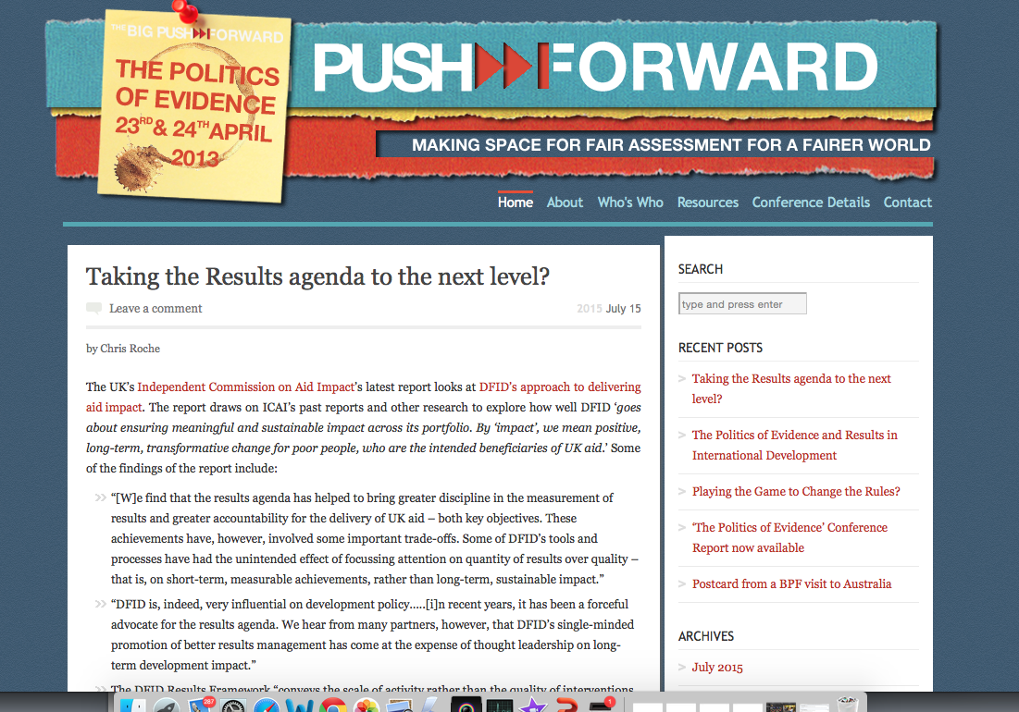
April 2013 - Contingent Effects
Empowering:
  More financial responsibility within organisations
  Understanding of citizens’ perceptions of value (SROI)
  Small organisations showing relative cost efficiency
New alliances and creative ideas:
  DFID staff setting up debates about hard to measure results
Disempowering and affecting relationships:
  Donor driven focus on economy & efficiency undermining effectiveness
  Economic measurement too narrow

Slide 20
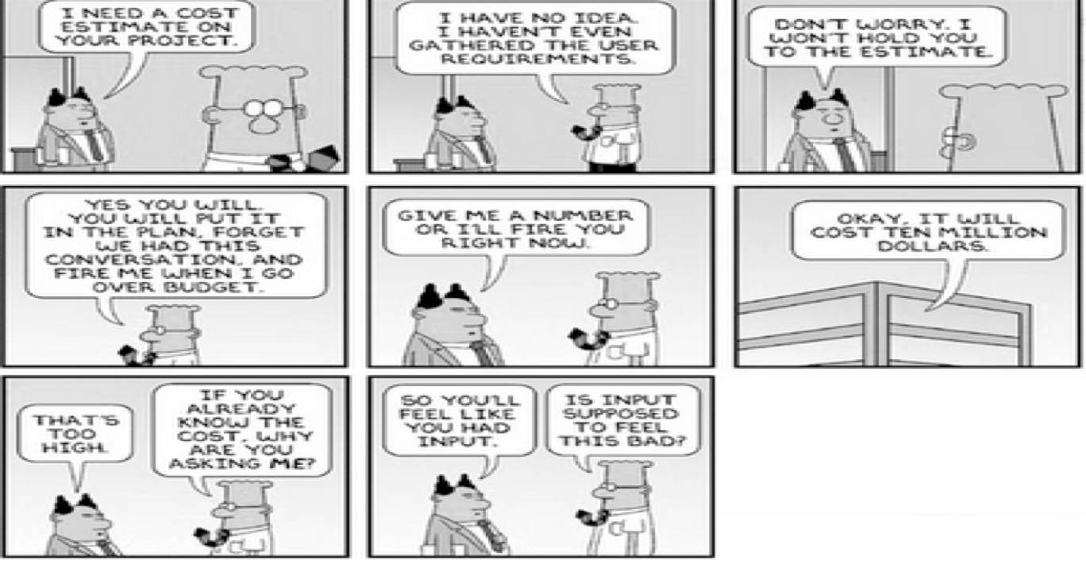
Disempowering Effect

Slide 21
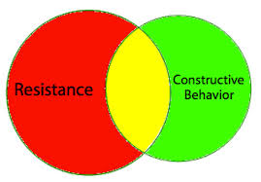
Tactics for Increasing
Transformative Potential
Defining context specific approaches shaped by values
Identifying whose values
Appropriating complexity science
Incorporating equity
Shielding partners
Valuing relationships
Including non-monetised costs

Slide 22
Conclusion: What Needs To Change?
VFM is an important principle
It is confusing, hard to apply and can pose dilemmas for those supporting transformational development
What needs to change? Power awareness:
  Acknowledge roles in shaping the rules of the VFM game
  Use agency and collective action across organisational boundaries to avoid narrow interpretations
  Take up opportunities to challenge assumptions and debate what kind of development is valued

Slide 23
The Politics of Results and Transformational Development
– What Needs to Change?
Janet Vähämäki
Co-author,
PhD Candidate at SCORE
and Stockholm Business School

Slide 24
The results agenda in Swedish development cooperation: cycles of failure or reform success?
Janet Vähämäki
Stockholm Business School and SCORE

Slide 25
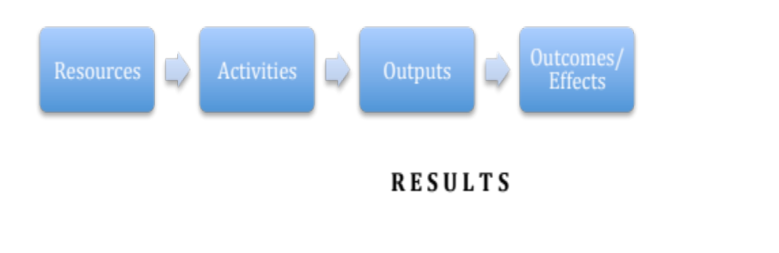

Politics of ‘results’
WE WANT TO SEE RESULTS!!!
The “programme”
The “technology”

Slide 26
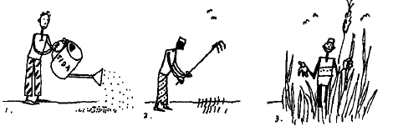
‘Results’

Slide 27
The idea
Transformational
Development
Programme
Technology
Practice
Time

Slide 28
Previous research
Programme
Technology
Practice
Time

Slide 29
My research
1971
SIDA Results Valuation Programme
1981
SIDA Project –Programme Follow-Up
1998
Sida Rating System
2012
Results Summary
?

Slide 30
Typical difficulties
Difficulties with definition, measurement, aggregation, attribution, finding indicators.
Resistance from staff
Purpose and end user?
Results information not used
Low use of the technology
Costs?

Slide 31
Typical difficulties
“There were always difficulties to prove the relation between Swedish funding and its impacts.”
    -Sida staff 1970
“We do not understand what is meant by ‘results’ and the indicators that you want in order to measure results”.
..”the requirements are becoming so extensive that time is poorly allowed for doing wise assessments”.
-Sida staff 2012

Slide 32
The latest reform: 2006-2013
“I will not give up. We must work more results oriented in aid. We must be able to tell the Parliament and the voters of all positive things that are done in a comprehensive way. We must also have a totally different documentation and systematisation in how we think of results in aid.”
-Minister of Development Aid 2011
“I am absolutely convinced that both the new grant management procedure and the standardized indicators and monitoring of results will give stability in the working processes. The working atmosphere for the individual programme officer will become much clearer”
–Sida Director 2012

Slide 33
Sidas response 2012
How to drive culture change within Sida?
- Well, it
will blow over.
Denial
Attendance
-We will be
best in the
world!
-But, we are not a business company!
Anger
Changeover
- Wow,we can notice it in media and the MFA!
-We are considered
unserious if we do it
Anxiety
Negotiation
- Result focus yes, but not down to counting every SEK
Apathy
Acceptance
Ok, now it is as it is. We need to
do something good about it.
I work at Sida to help poor people, not to insert numbers in excel..
Distress
Now everything is about results and money. It was better before.

Slide 34
The current reform
A cycle of failure or reform success?
Earlier | Now
Results –a technical sub-theme | Results –the political agenda
Results –for the recipient | Results –for Communication (Swedish taxpayers)
Sida- a policy organisation “Do the right things” | Sida –a management organisation “Do things right”
A question for few | -A question for the whole organisation -More knowledge on how to
Weak support in Board of Directors | Top priority for Board of Directors
Internationally: support | Internationally: High pressure

Slide 35
Cycle of failure?
“Our weakest link is where development is produced, i.e. the recipient countries. The Government’s new steering has probably not had any impact on the ground…but maybe it will come later.”

Slide 36
Reform success?
“My feeling is that the process of results strategies stimulated many conversations about results and thus increased the competence at Sida of the issues…
There was for some time a hard push to quantify what can be quantified but now the attitudes have changed”.

Slide 37
My preliminary findings
Programme
Technology
Practice
?
Time

Slide 38
The Politics of Results and Transformational Development
– What Needs to Change?
Ulrika Modéer
State Secretary
Kim Forss
Evaluation and Development specialist,
Andante – tools for thinking
Henrik Arnstad
Science Journalist
Anna Liljelund
Consultant/Advisor, Indevelop
Moderator: Göran Sundström

Slide 39
The Politics of Results and Transformational Development
– What Needs to Change?

